Slide 1
Optimizing Visualization Performance on Power-Limited Supercomputers
Dissertation Defense
4 March 2019
Stephanie Labasan

Slide 2
Dissertation Question
“Can Visualization Be Optimized on Power-Limited Supercomputers?”
Involves the intersection of two topics:
Power-constrained high performance computing
Scientific visualization

Slide 3
Outline
Background and Motivation
Dissertation Results: Visualization workloads are different than simulation workloads…leads to two questions:
How different are visualization workloads?
How does this affect power optimization strategies?
Synthesis and Future Work
Characterize Data Intensity
Power Scheduling

Slide 4
Outline
Background and Motivation
Dissertation Results: Visualization workloads are different than simulation workloads…leads to two questions:
How different are visualization workloads?
How does this affect power optimization strategies?
Synthesis and Future Work
Characterize Data Intensity
Power Scheduling

Slide 5
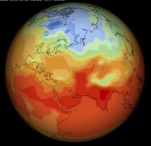
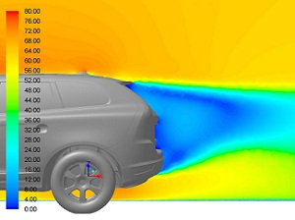

What is high performance computing (HPC)?
Enabling technology for scientific discoveries through simulation
Weather prediction, design simulation, genomics research, medical imaging, and more!
Leverages computational capacity of several thousand interconnected processing units
Performance measured in FLOPS = floating-point operations per second
Linpack: highly-optimized compute-intensive standard benchmark
1 TeraFLOPS | 10¹² | 1997 (ASCI Red, Sandia)
1 PetaFLOPS | 1K TFLOPS | 2008 (Roadrunner, LANL)
1 ExaFLOPS | 1M TFLOPS | ~2023
Notes:
HPC is an enabling technology allowing our scientists and engineers to solve highly complex scientific problems.

Slide 6
Current system power utilization is sub-optimal
2.4 MW:
Assumes all nodes consume peak power at the same time
2.32 MW, Linpack
1 MW Un-used!
40% Un-used!
1.47 MW, Other codes
0.83 MW, Other codes
Limits the size of the system, reducing system throughput
Power capacity left on the table, more science could be done
Notes:
Here I’m showing the total system power usage for the BGQ Vulcan supercomputer at LLNL over the course of several years dating back to the a couple weeks ago.

Slide 7
Total system power usage and costs are rising
Power becoming an increasingly scarce resource
Expensive cost
Limitations enforced by supercomputer facilities
Target is 20-40 MW system power usage for 1 Exaflop (SciDAC 2016)
Need to effectively schedule limited power resources
Important premise for this research: To meet power consumption goals at exascale, need to innovate power-efficient techniques not only in hardware, but also in software
Notes:
Total system power usage is rising quickly as we move from generation to generation. Over the last decade, there have been innovations mostly driven by HW that have improved our power efficiency, but power continued to become an increasingly limited resource.
20-40MW cite: https://science.energy.gov/ascr/research/scidac/exascale-challenges/ (3/5/2016)

Slide 8
In a power-limited environment, performance of visualization routines will be affected
Central manager coordinating power allocations across system
Lots of research focusing on simulations under a power limit
We are moving towards a workflow where the visualization and analysis are concurrently running with the simulation
This research: visualization component under a power limit
Notes:
With the push to exascale, power limitations will affect all of the applications running on the system, from scientific simulation to visualization and analysis workloads. In order to reach our computational demands, we need to use the power wisely.

Slide 9
Visualization in a power-limited environment is an important topic
#1: Visualization is important for scientific insight
#2: Visualization can use significant resources on the HPC resource (10%-20% of the total runtime), meaning optimizing visualization will be beneficial
#3: The computing workload for visualization is different than that of simulation
Lots of operations (e.g., isovolume, contour, clip, ray tracing)
Data intensive, not compute intensive
Can be highly variable and imbalanced
Notes:
So why do we care about visualization? The first is because visualization is critical for providing scientific insight and discovery.

Slide 10
Visualization in a power-limited environment is an important topic
#1: Visualization is important for scientific insight
#2: Visualization can use significant resources on the HPC resource (10%-20% of the total runtime), meaning optimizing visualization will be beneficial
#3: The computing workload for visualization is different than that of simulation
Lots of operations (e.g., isovolume, contour, clip, ray tracing)
Data intensive, not compute intensive
Can be highly variable and imbalanced
Notes:
So why do we care about visualization? The first is because visualization is critical for providing scientific insight and discovery.

Slide 11
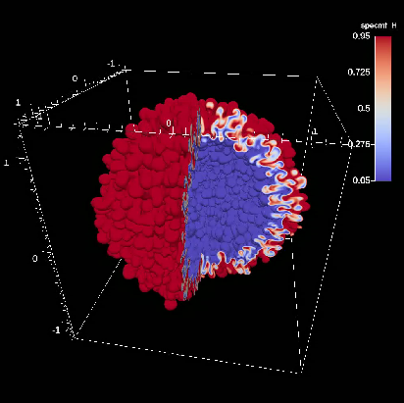
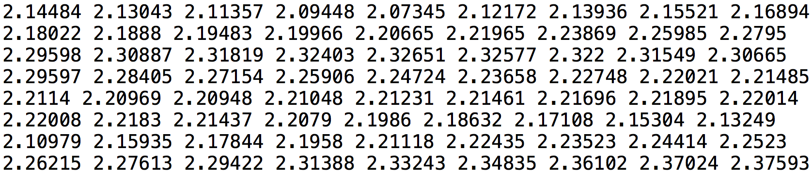
Visualization is important to understanding scientific simulation data
Central actor in the scientific discovery process:
Three use cases:
Communicate
Validate
Explore
Sim
Data
Visualization Algorithms
Render
Image(s)
Display
Notes:
Visualization and analysis is a key component of the scientific discovery process. It allows us to transform abstract data into a comprehensible image.
Visualize, analyze, and understand the data sets
Communicate examples – data analysis, images/movies
Validate examples – Data analysis, images/movies, comparison
Exploration examples – scientific discovery, debugging

Slide 12
Visualization in a power-limited environment is an important topic
#1: Visualization is important for scientific insight
#2: Visualization can use significant resources on the HPC resource (10%-20% of the total runtime), meaning optimizing visualization will be beneficial
#3: The computing workload for visualization is different than that of simulation
Lots of operations (e.g., isovolume, contour, clip, ray tracing)
Data intensive, not compute intensive
Can be highly variable and imbalanced
Notes:
So why do we care about visualization? The first is because visualization is critical for providing scientific insight and discovery.

Slide 13
Visualization workflow is traditionally post hoc
First, simulation writes data to disk at regular time steps
Then, visualization program reads in data, performs operations, and displays results to user
Data can be explored by scientists at leisurely time scales
Simulation
Time step 20, 40, 60, …
Disk Write
Disk Read
Visualization
Visualization algorithms,
render images
Display
c/o V. Adhinarayanan
Notes:
The visualization workflow is traditionally a post hoc process.

Slide 14
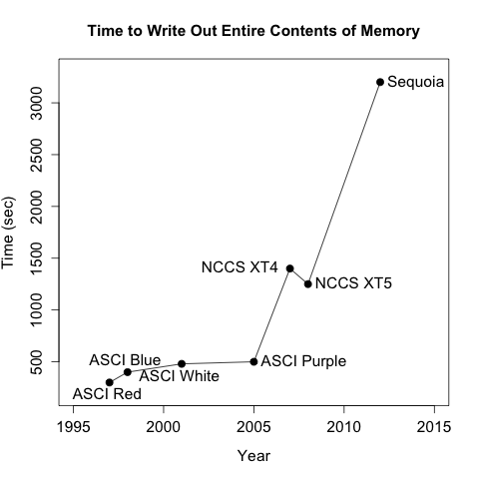
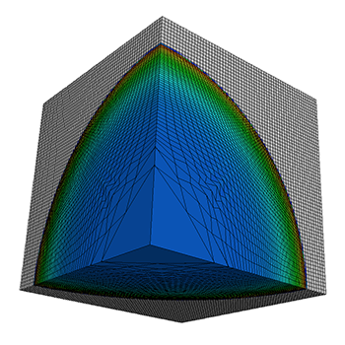

Post hoc processing not feasible at exascale
Compute – and thus ability to generate data – is increasing faster than I/O
Simulation codes should throttle rate of data saved
I/O gap limits ability to save data with high frequency
Result is temporal sparsity
Step 0
Step 500
Step 1000
c/o M. Larsen, B. Whitlock
Notes:
One of the challenges at exascale is that the rate at which our simulations are able to generate data is greatly outpacing the rate at which we can save it.
River analogy: May change course in between time steps.
https://pdfs.semanticscholar.org/presentation/a593/67e0eb7671093130e35e3b82461db1d1f2ec.pdf
While I/O bandwidth is increasing, the rate at which simulations generate data is increasing at a faster rate

Slide 15
Transition to in situ visualization to bypass I/O gap
Data analysis and visualization occur while simulation is running
No storage of simulation’s state needed
Changes to HPC ecosystem pose challenges for visualization
Total execution time may increase since compute resources are shared
Notes:
The visualization community is transition to in situ to bypass the I/O gap.
Information must be extracted in real-time

Slide 16
Visualization in a power-limited environment is an important topic
#1: Visualization is important for scientific insight
#2: Visualization can use significant resources on the HPC resource (10%-20% of the total runtime), meaning optimizing visualization will be beneficial
#3: The computing workload for visualization is different than that of simulation
Lots of operations (e.g., isovolume, contour, clip, ray tracing)
Data intensive, not compute intensive
Can be highly variable and imbalanced
Notes:
So why do we care about visualization? The first is because visualization is critical for providing scientific insight and discovery.

Slide 17
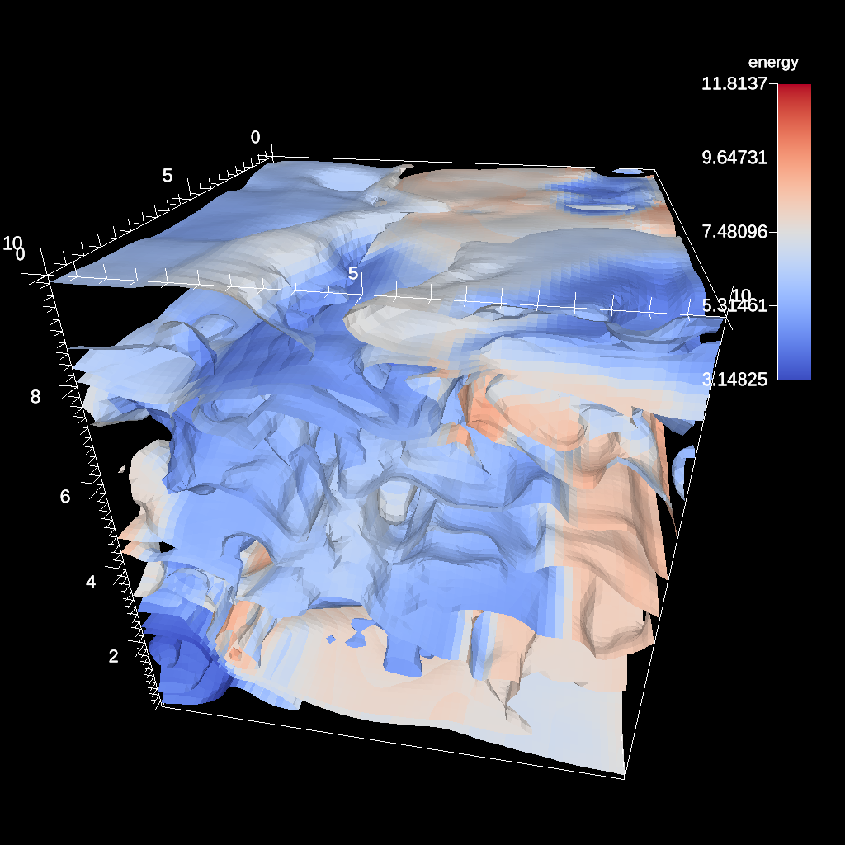
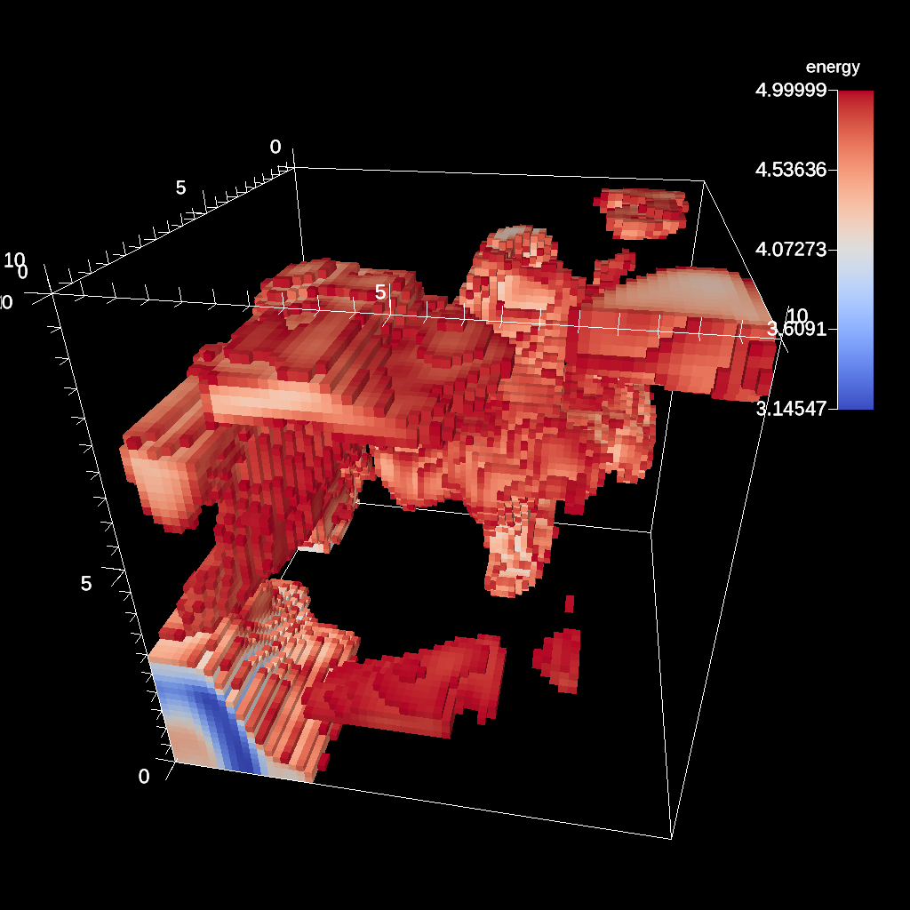
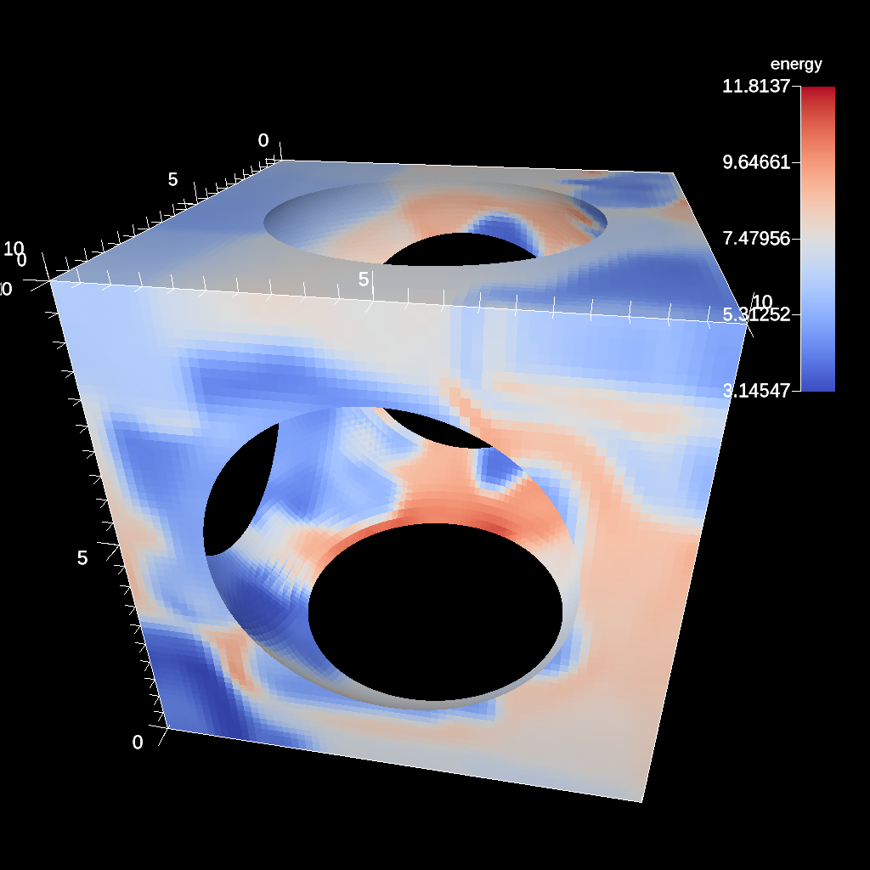
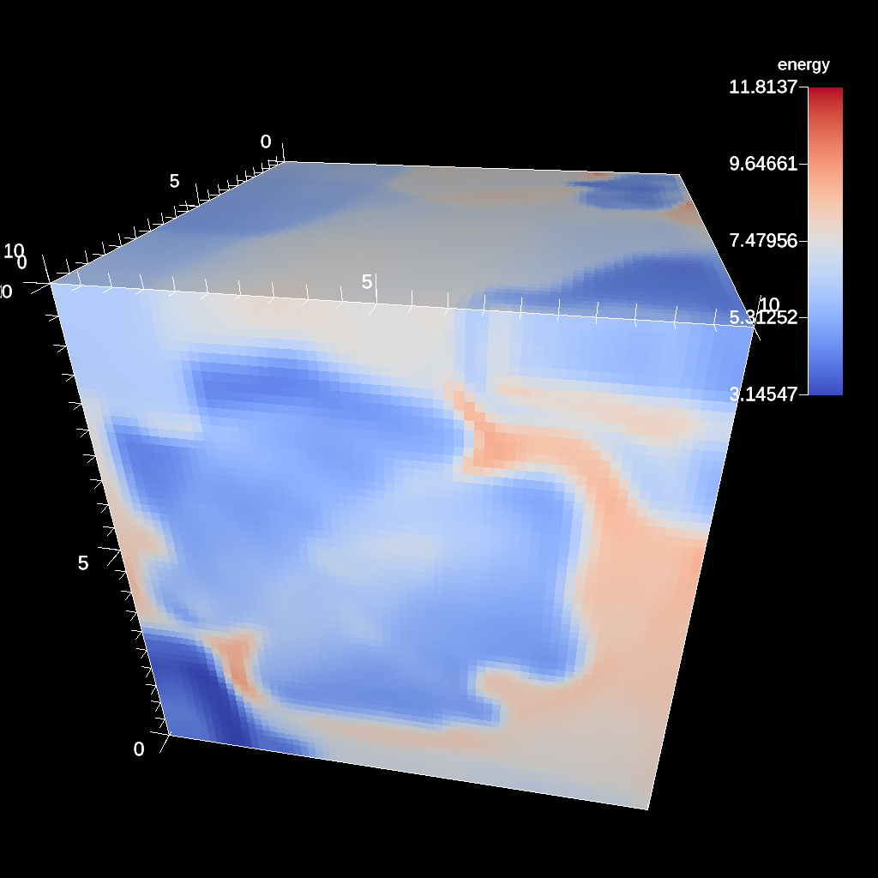
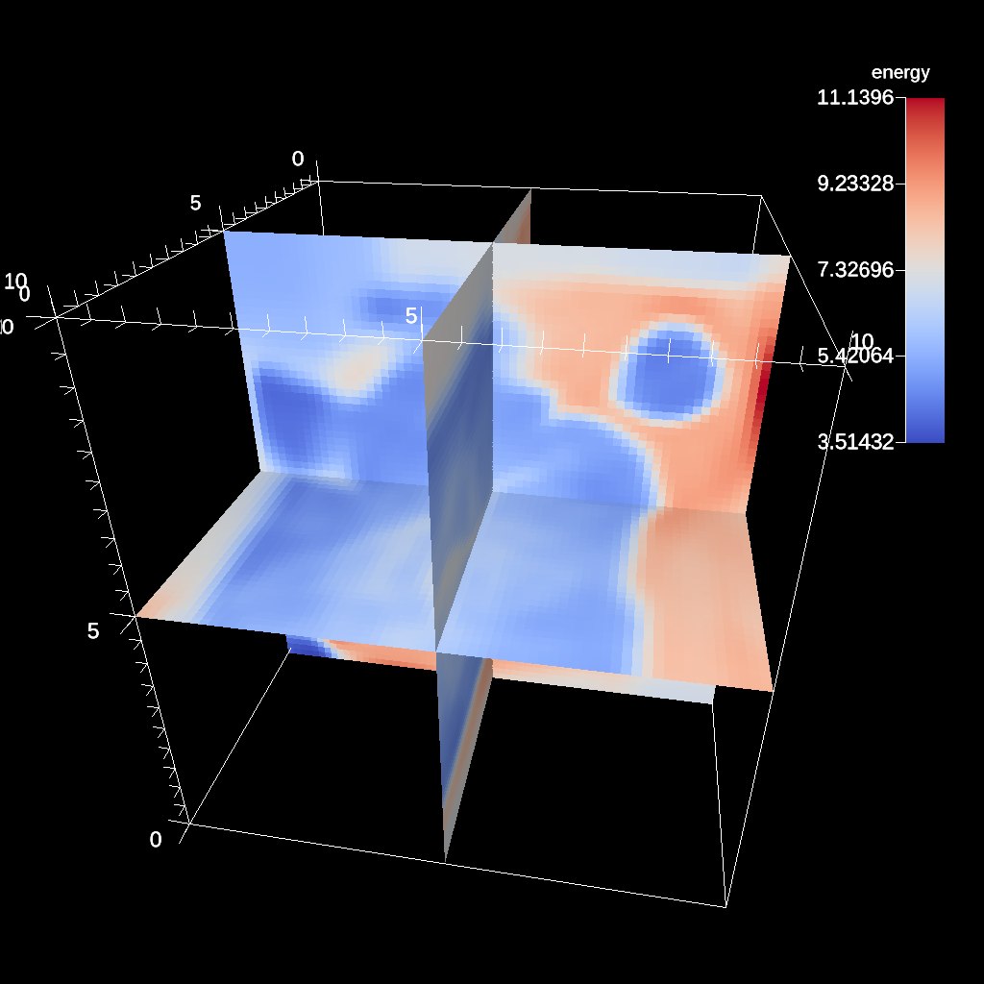
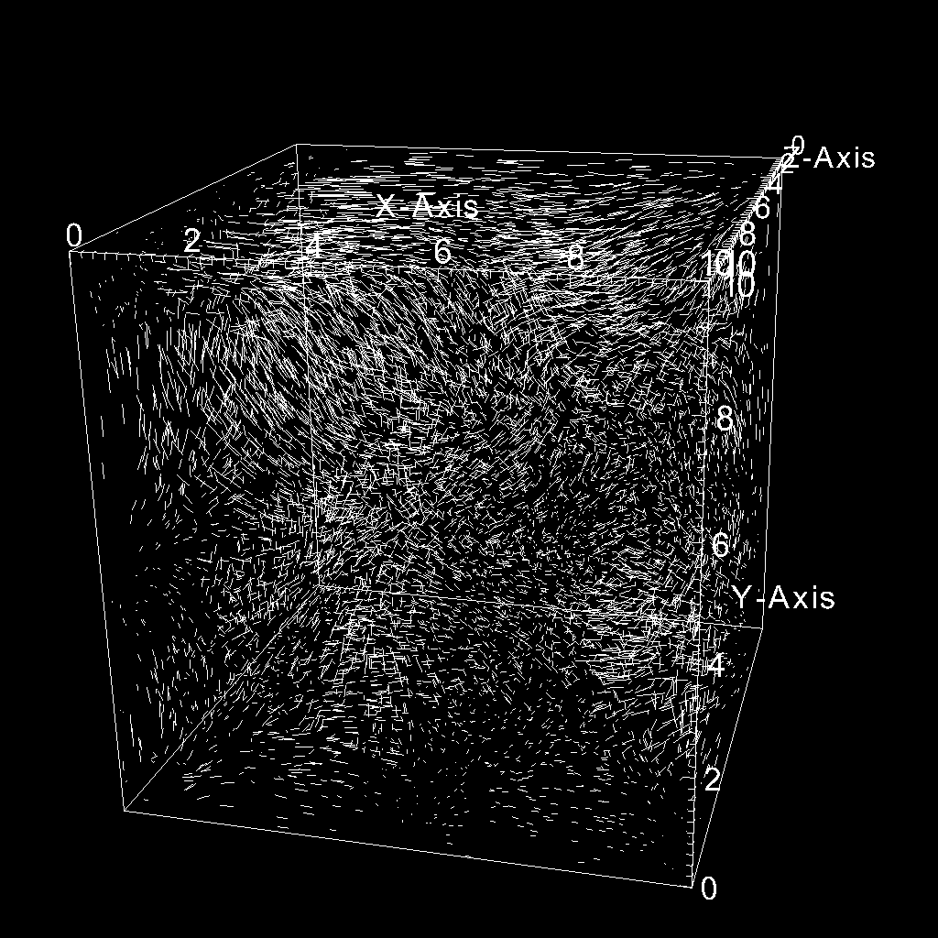
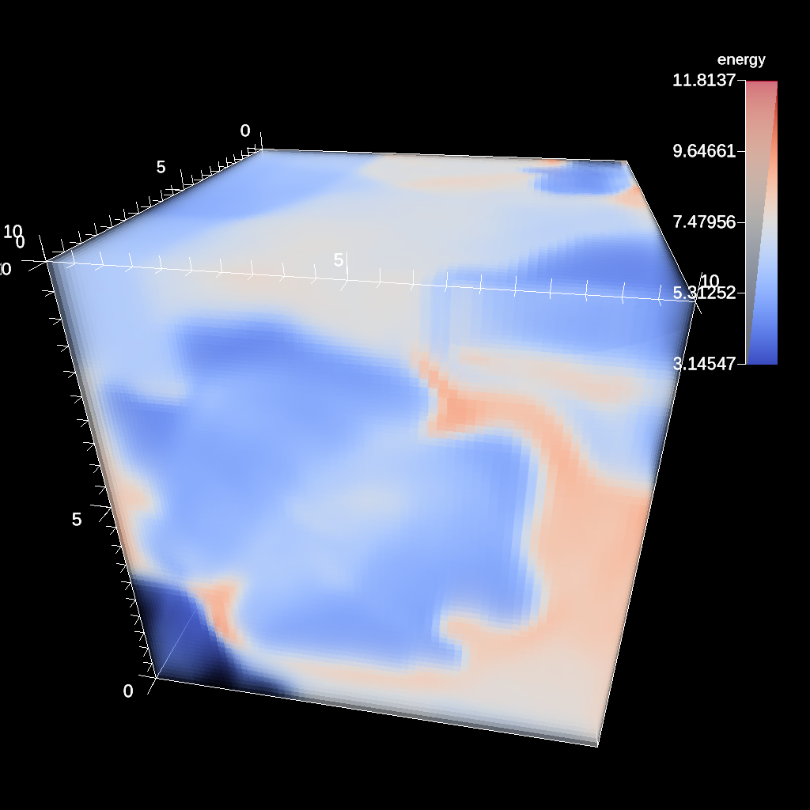
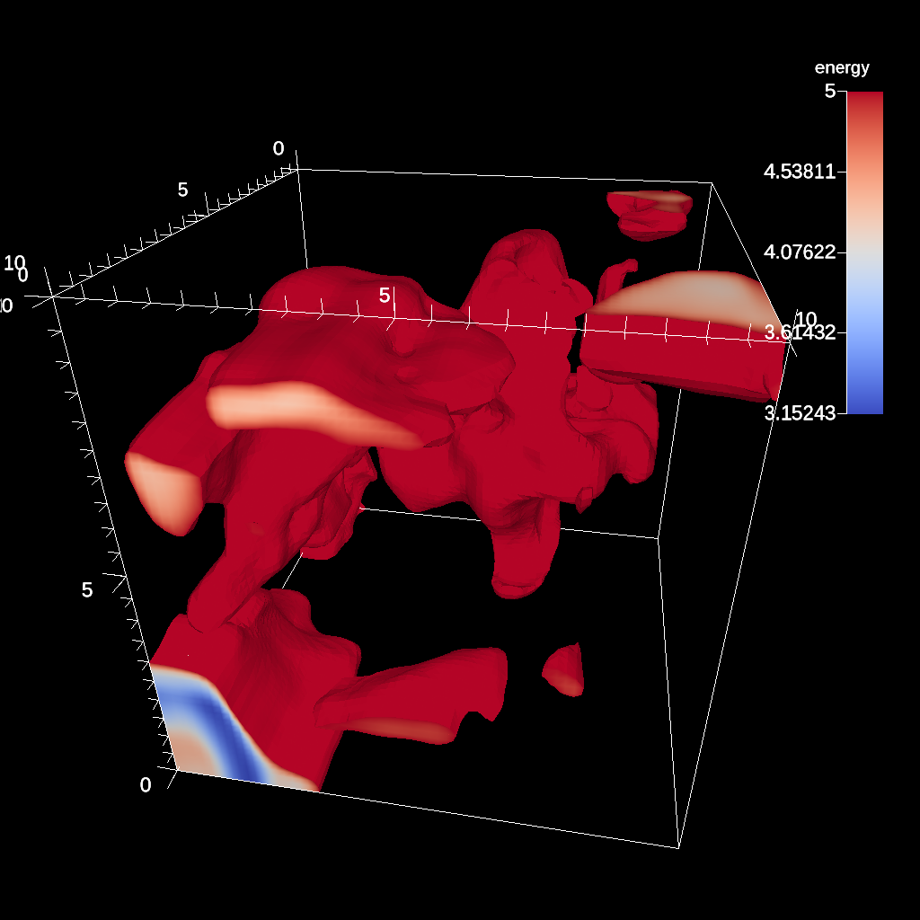
There are many visualization algorithms
Execution behaviors differ across algorithms
Unique configurations for each algorithm
Pipeline algorithms together
Output data generated conditionally based on input value
Isovalue(s),
Number of contours
Min/Max
Radius,
Center
Camera position,
Image resolution,
Number of samples
Contour
Threshold
Spherical Clip
Ray Tracing
Position,
Normal
Number of seeded particles,
Step length,
Number of steps
Camera position,
Image resolution,
Transfer function,
Number of samples
Min/Max
Slice
Particle Advection
Volume Render
Isovolume
CloverLeaf 200th cycle
Notes:
There are many many different visualization operations to choose from depending on what you are interested in.
Simulation workloads typically have 1 key loop. If you focus optimization efforts on this loop, then simulation gets better performance.
There are many operations in visualization, which are highly varied (between each op)

Slide 18
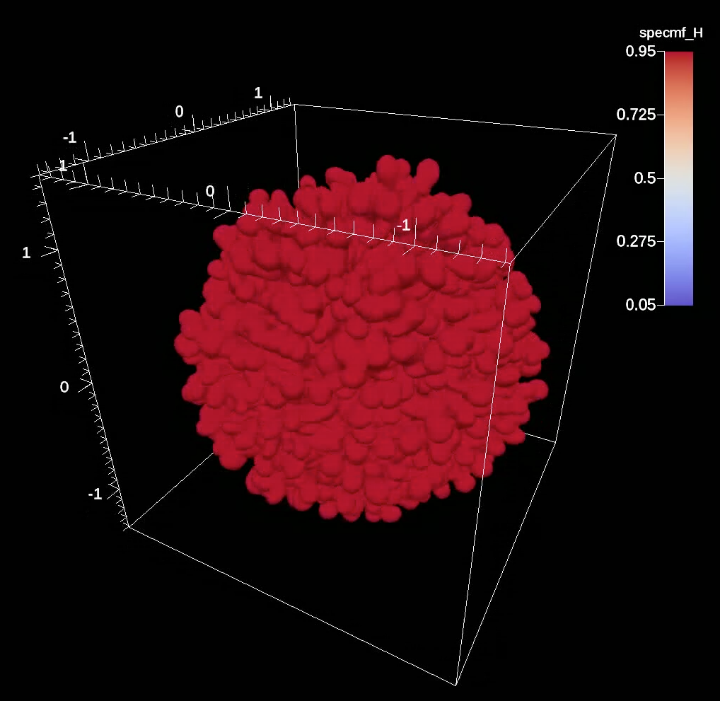
In situ load imbalance example: Ares
RT Mixing Layer in a Convergent Geometry
4π, 1.52B zones
29,375 cycles
ALE Hydrodynamics
Dynamic Species
Light fluid
Heavy fluid
Slice of Ares data set
Isovolume of mixing layer
Clip quarter of data set
100% of ranks
~50% of ranks
~37.5% of ranks
We cannot address load imbalances directly by redistributing work, since memory is shared between simulation and visualization.
Instead, we redistribute power to the source of imbalance.
c/o M. Larsen
Notes:
Here is one example showing how load imbalance can manifest itself in an in situ workflow. The simulation used here is Ares, a radiation hydrodynamics proxy application. For this particular simulation, the scientists were interested in the mixing layer of the heavy and light fluid.
Addressing load imbalances is a fundamentally challenging problem. Typically, we physically transfer the data across compute units. This problem becomes more challenging on power limited systems. This method enables us to address the imbalance in a power-limited system.
Create an isovolume to see isolate cells near the mixing layer. iterates over every cell in a mesh and determines which parts of the cell, if any, contain a value that falls within a specified data range.
Not addressing load imbalancing directly in this work, but understanding where the load imbalance is to redirect power
Radiation hydrodynamics code
RT=Raleigh taylor

Slide 19
Dissertation Plan
Dissertation Question: “Can Visualization Be Optimized on Power-Limited Supercomputers?”
Focus: Visualization workloads are different than simulation workloads
First: Understand variation within different visualization workloads
Explore execution behaviors with reduced CPU clock frequencies and power limits
Second: Exploit the variation by dynamically re-allocating power
Labasan et al. “Exploring Tradeoffs Between Power/Performance for a Vis Algorithm.” IEEE Symposium on Large Data Analysis and Visualization (LDAV), 10/2015.
Labasan et al. “PaViz: A Power-Adaptive Framework for Optimizing Vis Performance.” Eurographics Symposium on Parallel Graphics and Visualization (EGPGV), 06/2017.
Time
Labasan et al. “Power/Performance Tradeoffs for Vis Algorithms.” Accepted for publication at IEEE International Parallel and Distributed Processing Symposium (IPDPS).
Labasan et al. “Evaluating Predictive and Adaptive Power Strategies for Optimizing Vis Performance.” In preparation for submission at IEEE Transactions on Parallel and Distributed Systems (TPDS).
Notes:
Firstly, I want to present the overarching thesis question, which is ”Can scientific visualization workloads be optimized on power-limited systems?”

Slide 20
Outline
Background and Motivation
Dissertation Results: Visualization workloads are different than simulation workloads…leads to two questions:
How different are visualization workloads?
Is there an opportunity for power savings in data intensive algorithms?
How does this affect power optimization strategies?
Synthesis and Future Work
Characterize Data Intensity
Power Scheduling
Notes:
Here is the outline for this talk. I will first start with a background of the two topics at the intersection of this thesis.

Slide 21
Are there power saving opportunities for visualization workloads?
Motivation: Power is becoming a constrained resource in HPC
Goal: Save energy/power
Idea: Reduce CPU clock frequency or enforce hard power limit
These ideas are well-suited specifically for visualization
Visualization is data intensive
Proposition for users: Run X% slower, save Y% in energy/power
Study: Explore a set of visualization algorithms and investigate which factors most affect X and Y
Two Results:
Initial exploration, show it’s possible
Looked at 1 algorithm (isosurfacing) under DVFS
Thorough study, understand conditions where variation occurs
Looked at 8 algorithms under power limits
Labasan et al. “Exploring Tradeoffs Between Power/Performance for a Vis Algorithm.” IEEE Symposium on Large Data Analysis and Visualization (LDAV), 10/2015.
Labasan et al. “Power/Performance Tradeoffs for Vis Algorithms.” Accepted for publication at IEEE International Parallel and Distributed Processing Symposium (IPDPS)
Notes:
Since power is becoming a limited resource looking forward, the goal is to save energy/power. Two ways of doing this is to reduce the CPU clock frequency or enforce a hard power limit on the processor. These ideas are well suited for visualization since they are data intensive.

Slide 22
Are there power saving opportunities for visualization workloads?
Motivation: Power is becoming a constrained resource in HPC
Goal: Save energy/power
Idea: Reduce CPU clock frequency or enforce hard power limit
These ideas are well-suited specifically for visualization
Visualization is data intensive
Proposition for users: Run X% slower, save Y% in energy/power
Study: Explore a set of visualization algorithms and investigate which factors most affect X and Y
Two Results:
Initial exploration, show it’s possible
Looked at 1 algorithm (isosurfacing) under DVFS
Thorough study, understand conditions where variation occurs
Looked at 8 algorithms under power limits
Labasan et al. “Exploring Tradeoffs Between Power/Performance for a Vis Algorithm.” IEEE Symposium on Large Data Analysis and Visualization (LDAV), 10/2015.
Labasan et al. “Power/Performance Tradeoffs for Vis Algorithms.” Accepted for publication at IEEE International Parallel and Distributed Processing Symposium (IPDPS).
Notes:
Since power is becoming a limited resource looking forward, the goal is to save energy/power. Two ways of doing this is to reduce the CPU clock frequency or enforce a hard power limit on the processor. These ideas are well suited for visualization since they are data intensive.

Slide 23
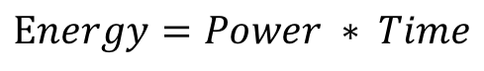
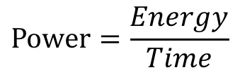
Save energy? Save power?
Energy
Total work done
For a single application execution, minimize energy consumption ($$)
Energy-to-solution
$$Energy=Power ∗ Time$$
Power
Rate of energy usage
Reduce rate at which application consumes energy
Increase concurrent jobs (maximize throughput)
$$Power=\frac{Energy}{Time}$$
Saving power may/may not save $$ or energy
Run at 40W: take 10 seconds = 400J
Run at 30W: take 15 seconds = 450J
Notes:
Before we dive too much further, I wanted to take a moment to define two key terms.
Blue box across both columns

Slide 24
Power-Saving Technique: Reduce Clock Frequency
Outcome: Takes longer to run, but uses less power
Why: Non-linear relationship between frequency and power
Reduced clock frequency results in less power consumption
But, subcomponents still consume power at the same rate
Will lead to power savings
May lead to energy savings, may not
2X
2X
1.4X
1X
Compute-bound
Memory-bound
Notes:
The outcome of reducing the CPU clock frequency or applying a power limit is that the time-to-solution increases, but it uses less power.

Slide 25
Shared clock frequency does not work for data intensive applications
Ideal outcome:
Reduce clock frequency
Achieve energy/power savings
Runtime does not change
Architecture with separate clock frequencies for cache and compute unit (e.g., Intel Haswell)
Enables reduction of clock frequency without impacting cache
Some visualization algorithms are data intensive
Core
0
1
2
3
L1
L1
L1
L1
Uncore
Last-Level Cache
Memory
Notes:
If we apply our strategy of slowing down the CPU clock frequency on data intensive workloads, like vis, then the ideal outcome is the following: we reduce the CPU clock frequency, we achieve savings in energy/power, and we do not impact the runtime. This does not happen in practice.

Slide 26
Research Questions & Methodology
Data intensity: If you are forced to reduce the clock frequency, how much slowdown will you see?
Energy proposition: If you are forced to use Y% less energy, you will run X% slower
Power proposition: If you are forced to use Z% less power, you will run X% slower
Explored isosurfacing algorithm with many configurations:
CPU frequency (7-11 options)
Data set (6 options)
Algorithm Implementation (2 options)
Hardware (2 options)
Notes:
This brings us to our research questions.

Slide 27
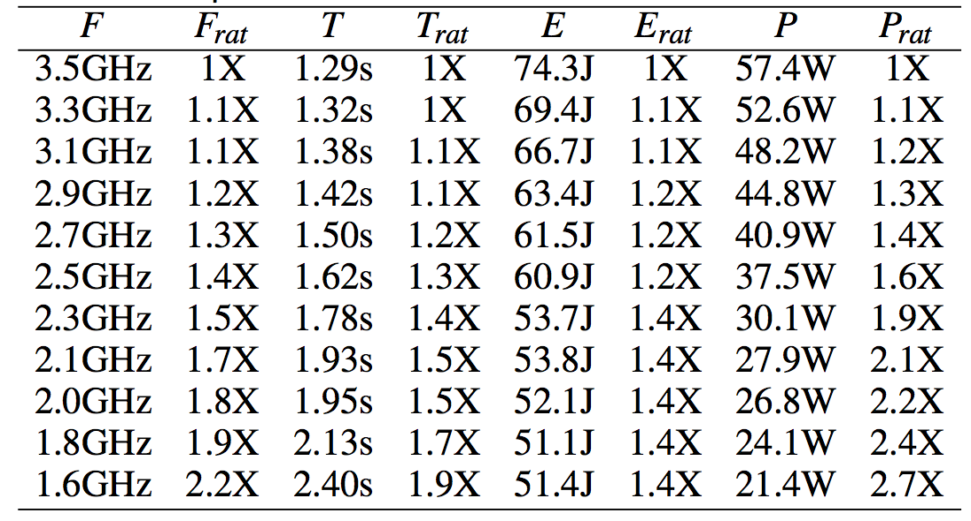
Phase 1 Results: Vary CPU Clock Frequency
Reducing clock frequency by 2.2X:
Runtime: increases by 1.9X
Energy: decreases by 1.4X
Power: decreases by 2.7X
Implementation tends towards compute intensive, but not as strongly as a traditional compute bound benchmark
E_{save}
Isosurfacing algorithm has favorable energy/power savings with reduction in frequency
Baseline Implementation, Enzo-10M, CPU1, OpenMP
Notes:
SLOW – walk through columns incrementally
FRAT = F_default / F_reduced
TRAT = T_reduced / T_default
ESAVE = E_default / E_reduced
PRAT = P_default / P_reduced

Slide 28
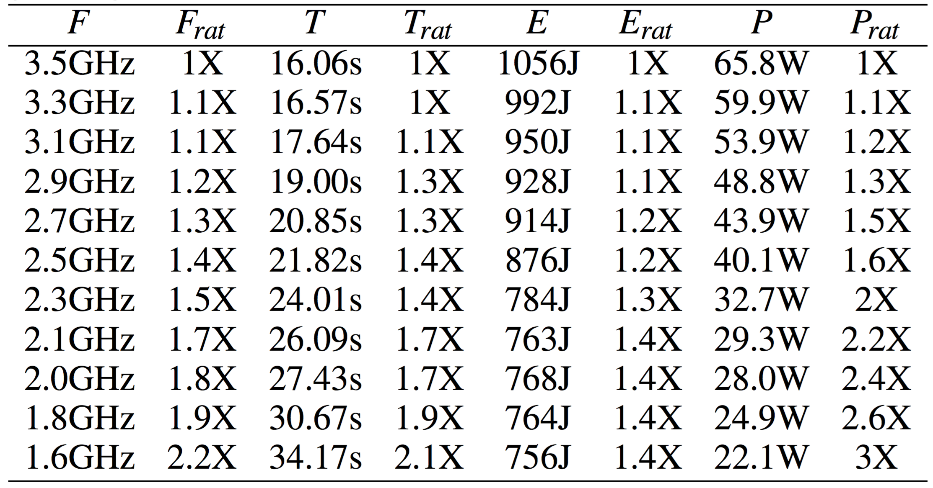
Phase 2 Results: Vary Algorithm Implementation ( )
Compute intensive: F_{rat} and T_{rat} are highly correlated
Number of instructions retired differs between implementations (102 billion vs. 7 billion)
E_{save}
VTK’s implementation shifts instruction mix from data to compute intensive and propositions become less favorable
VTK Implementation, Enzo-10M, CPU1, OpenMP
Notes:
VTK is an open Source library for visualization and graphics, basis for many end-user visualization tools (VisIt, ParaView)
Algorithm performs isosurfacing in a general way (many cell types, higher order elements, etc.).
Designed for extensibility, but comes with performance tradeoffs
SLOW – flip back and forth VTK is 16X longer, slowdown is proportional to clock frequency

Slide 29
Phase 3 Results: Vary Data Set
Smallest data set suffers largest impact to runtime with minimal energy savings
Energy savings: Improves for data sets with increased data intensity
Cache misses differ across data sets
Increasing data set complexity and size produces more favorable tradeoffs
Baseline Implementation, CPU1, OpenMP
Notes:
SLOW – explain axes, what is the size of the dots? Increase the data size complexity by increasing the number of cells and randomized the point indices such that accesses are irregular and locality is not maintained (worst case).
Goal: Investigate how data intensity and size affects our propositions
Smallest data set has largest slowdown and minimal energy savings.
All propositions improve as we increase data-intensity.

Slide 30
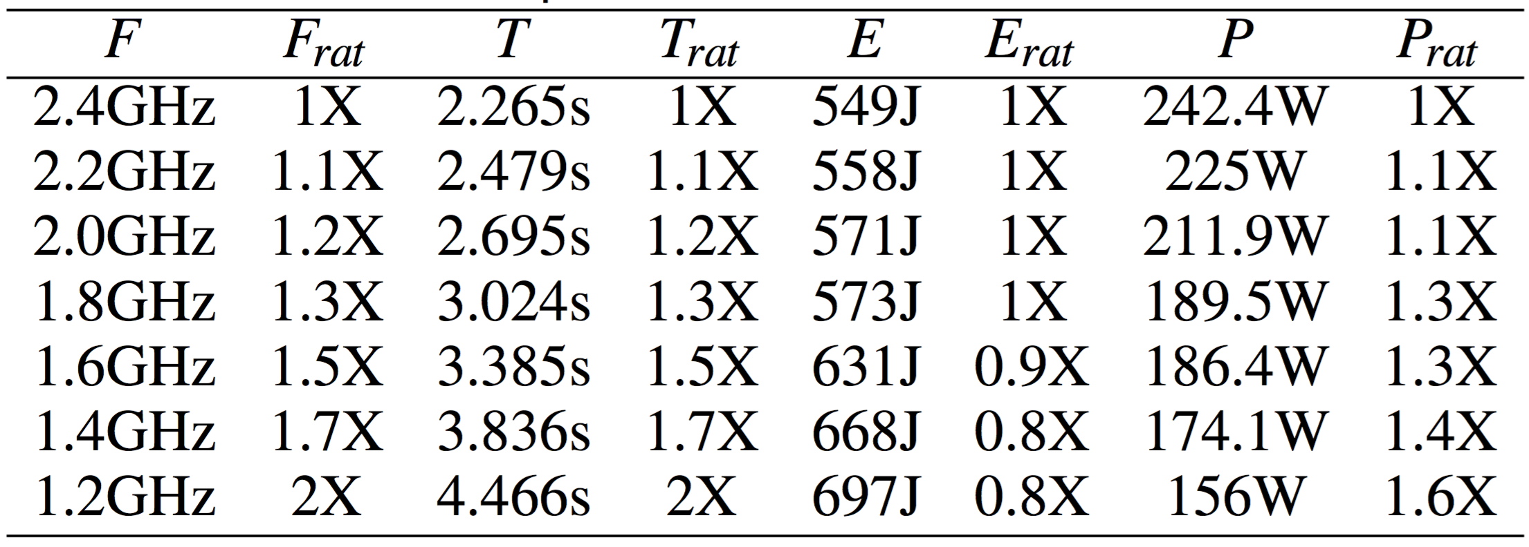
Phase 4 Results: Vary Processor Architecture
Change in clock frequency affects core and uncore on Intel Ivy Bridge
Propositions now unfavorable
Core
0
1
2
3
L1
L1
L1
L1
Last-Level Cache
Baseline Implementation, Enzo-10M, CPU2, MPI
Uncore
Hardware with shared clock frequency between core and uncore results in poor tradeoffs
Memory
Notes:
Reduction in clock frequency, results in a slowdown by this same factor (CPU bound), use more energy, so power goes down.
Nehalem – separate, Sandy Bridge – same, Ivy Bridge – same, Haswell – separate (switching between designs is simply a product of the team learning more about the architecture and understanding the best balance)
https://www.anandtech.com/show/6355/intels-haswell-architecture/10

Slide 31
Takeaways demonstrate opportunities for saving energy/power by reducing clock frequencies
Isosurfacing algorithm is sufficiently data intensive
Performance slowdown of 40% led to:
Power savings of 2.8X
Energy savings of 1.9X
Increasing data set complexity (e.g., size, irregular access patterns) results in better tradeoffs between runtime and energy/power
VTK implementation shifts instruction counts, resulting in less favorable tradeoffs between runtime and energy/power savings
Next research question: Is there variation among other visualization algorithms?

Slide 32
Are there power saving opportunities for visualization workloads?
Motivation: Power is becoming a constrained resource in HPC
Goal: Save energy/power
Idea: Reduce CPU clock frequency or enforce hard power limit
These ideas are well-suited specifically for visualization
Visualization is data intensive
Proposition for users: Run X% slower, save Y% in energy/power
Study: Explore a set of visualization algorithms and investigate which factors most affect X and Y
Two Results:
Initial exploration, show it’s possible
Looked at 1 algorithm (isosurfacing) under DVFS
Thorough study, understand conditions where variation occurs
Looked at 8 algorithms under power limits
Labasan et al. “Exploring Tradeoffs Between Power/Performance for a Vis Algorithm.” IEEE Symposium on Large Data Analysis and Visualization (LDAV), 10/2015.
Labasan et al. “Power/Performance Tradeoffs for Vis Algorithms.” Accepted for publication at IEEE International Parallel and Distributed Processing Symposium (IPDPS).
Notes:
Since power is becoming a limited resource looking forward, the goal is to save energy/power. Two ways of doing this is to reduce the CPU clock frequency or enforce a hard power cap on the processor. These ideas are well suited for visualization since they are data intensive.

Slide 33
: Accelerating VTK for many-core architectures
Targets on-node parallelism using data parallel primitives
Framework for simplifying the design of visualization algorithms on future architectures
http://m.vtk.org
Notes:
Provides a portable performance solution similar to RAJA but specific to vis
KMoreland: However, this is not true for all visualization algorithms, many of which generate data conditionally based on the input values. With only a few exceptions, current parallel visualization functions completely ignore this load imbalance, which is considered tolerable when amortized over larger partitions.

Slide 34
Study Factors
Processor-level power limit
9 options
Visualization algorithm
8 options
LLNL RZTopaz Broadwell node
CPU cap ranges from 120W (TDP) down to 40W
Contour
Threshold
Spherical Clip
Ray Tracing
Slice
Particle Advection
Volume Render
Isovolume

Slide 35


Result from this study: Most algorithms provide opportunities for power savings
Power Opportunity
Performance remains constant until lowest power limit
Power Sensitive
Performance degrades relative to power limit
Compute-bound workloads
Contour
Threshold
Spherical Clip
Particle Advection
Volume Render
*Ray tracing includes 3 operations: (1) find external faces (50%), (2) build spatial acceleration structure, and (3) trace rays
Slice
Isovolume
Ray Tracing*
Notes:
What is power opportunity? These are algorithms that can achieve significant power savings without slowing down.
Ray tracing algorithm = find external faces, build acceleration structure, and trace rays

Slide 36
Comparing power opportunity and power sensitive algorithms (Consider 1 example from each)
Power Opportunity: Threshold
Iterate over the cells in data set
Remove cells that do not have values in the specified range
Simple computation dominated by loads and stores of each cell
Power Sensitive: Particle Advection
Place a massless particle at a seed location
Displace the particle according to the vector field
Result is an “integral curve” corresponding to the trajectory the particle travels – Euler, RK4, …
Threshold
Particle Advection

Slide 37
Power opportunity algorithms are data intensive, while power sensitive algorithms are compute intensive
Power Opportunity
Power Opportunity

Slide 38
Power opportunity algorithms are data intensive, while power sensitive algorithms are compute intensive
Power Sensitive
Power Sensitive

Slide 39
Takeaways inform how visualization algorithms can adapt to imposed power limits
VTK-m implementations are significantly data intensive to avoid a slowdown at a reduced power limit
Most algorithms consume low amounts of power, providing opportunities for energy/power savings (e.g., data intensive)
Notes:
VTK impelentation of isosurfacing, which performs isosurfacing in a general way – works on many cell types, higher order elements
Designed for extensibility, but comes with performance tradeoffs

Slide 40
Outline
Background and Motivation
Dissertation Results: Visualization workloads are different than simulation workloads…leads to two questions:
How different are visualization workloads?
How does this affect power optimization strategies?
Can we exploit execution behaviors to realize additional performance?
Synthesis and Future Work
Characterize Data Intensity
Power Scheduling
Notes:
Here is the outline for this talk. I will first start with a background of the two topics at the intersection of this thesis.

Slide 41
How can we exploit execution behaviors to improve performance of visualization algorithms?
Visualization algorithms can have more variance than simulation codes
Motivates an alternative approach for redistributing power: using prediction (rather than adaptation)
Two Results:
Show prediction is viable
Showed benefit incorporating prediction for volume rendering
Show prediction is beneficial
Extended EGPGV17, compare with runtime system using adaptation (GEOPM)
Labasan et al. “PaViz: A Power-Adaptive Framework for Optimizing Vis Performance.” Eurographics Symposium on Parallel Graphics and Visualization (EGPGV), 06/2017.
Labasan et al. “Evaluating Predictive and Adaptive Power Strategies for Optimizing Vis Performance.” In preparation for submission at IEEE Transactions on Parallel and Distributed Systems (TPDS).

Slide 42
How can we exploit execution behaviors to improve performance of visualization algorithms?
Visualization algorithms can have more variance than simulation codes
Motivates an alternative approach for redistributing power: using prediction (rather than adaptation)
Two Results:
Show prediction is viable
Showed benefit incorporating prediction for volume rendering
Show prediction is beneficial
Extended EGPGV17, compare with runtime system using adaptation (GEOPM)
Labasan et al. “PaViz: A Power-Adaptive Framework for Optimizing Vis Performance.” Eurographics Symposium on Parallel Graphics and Visualization (EGPGV), 06/2017.
Labasan et al. “Evaluating Predictive and Adaptive Power Strategies for Optimizing Vis Performance.” In preparation for submission at IEEE Transactions on Parallel and Distributed Systems (TPDS).

Slide 43
Use performance predictions to identify imbalance
Goal: Improve power utilization to maximize performance in a power-limited environment
Method: Enforce power limit, affecting the CPU frequency and voltage
Proposition for users: Slow down some nodes in order to speed up other nodes, improving overall execution time
Study: Use a performance model for rendering to dynamically redistribute per-node power to where it will do the most good

Slide 44
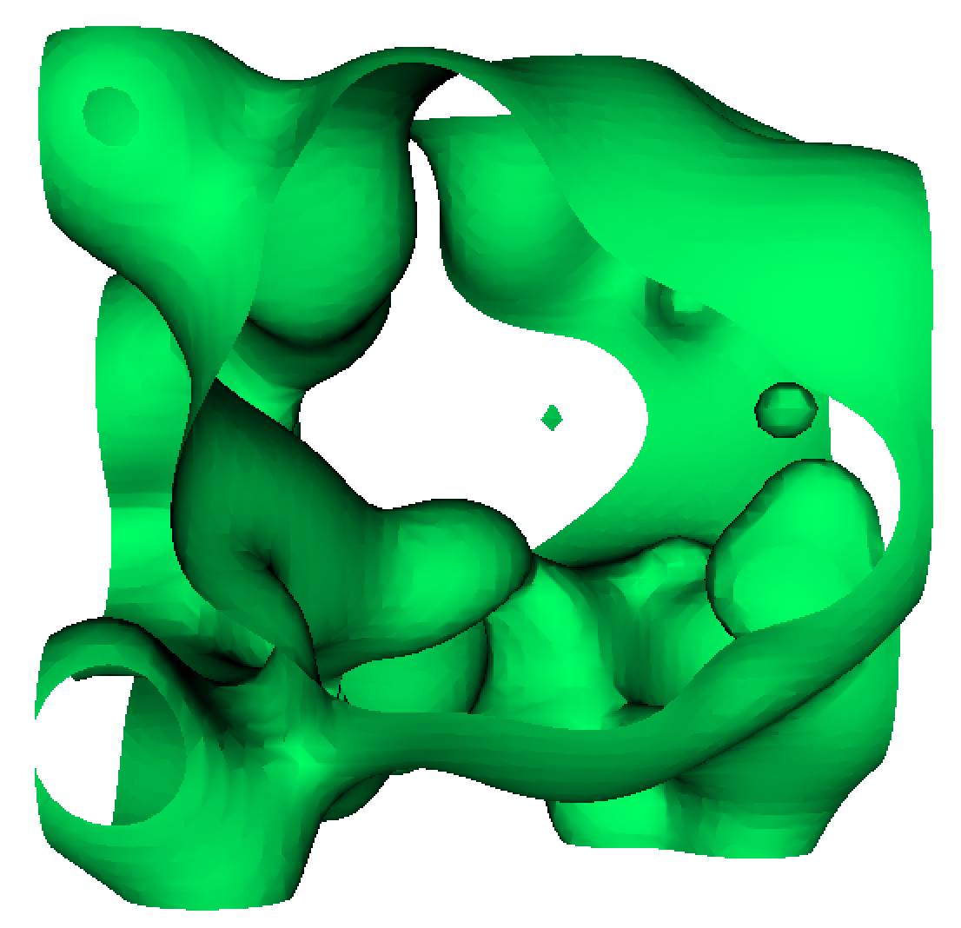
Imbalance in visualization routines poses an opportunity for performance improvements
Canonical example = isosurfacing
Geometry (i.e., work) will not be symmetrical
Work per node will vary...some nodes will have lots of work, others with no work
Give power to rank with lots of work
Take power away from rank with less work
Improve overall runtime
Ranks with less work
Rank with lots of work
Notes:
Load imbalances pose a performance challenge. The imbalance in visualization algorithms poses an opportunity for exploiting performance. Let’s consider the canonical example of isosurfacing, where every point on the surface is of a constant value. If we imagine this isosurface being decomposed across many ranks, we can see that the geometry or work is not symmetrical. There are some squares that are fully green and others that are white.
Isosurface = every point on the surface is of a constant value

Slide 45



Imbalance in visualization routines poses an opportunity for performance improvements
Canonical example = isosurfacing
Geometry (i.e., work) will not be symmetrical
Work per node will vary...some nodes will have lots of work, others with no work
Give power to rank with lots of work
Take power away from rank with less work
Improve overall runtime
Addressing load imbalances is challenging. Cannot simply move data between ranks.
Power
5W
5W
5W
= 15W
Rank
Notes:
In this example, we zoom in on three ranks with varying amounts of geometry. Our current strategy allocates uniform power to all ranks. In this example, we have a total of 15W, 5W per node.

Slide 46
Imbalance in visualization routines poses an opportunity for performance improvements
Canonical example = isosurfacing
Geometry (i.e., work) will not be symmetrical
Work per node will vary...some nodes will have lots of work, others with no work
Give power to rank with lots of work
Take power away from rank with less work
Improve overall runtime
So, which ranks have more work and which have less?
We need to know this before they start executing.
Idea: Use performance modeling.
9W
Power
4W
= 15W
2W
Rank

Slide 47
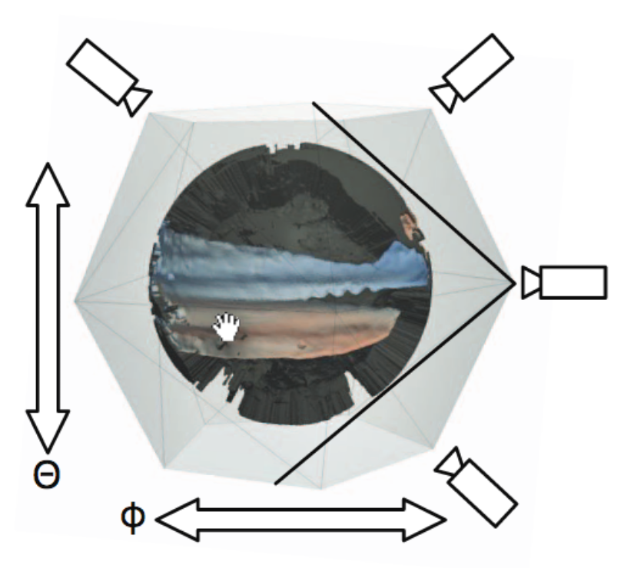
PaViz: Power-Aware Visualization Runtime Framework
This study: PaViz
Software power-aware runtime framework
Uses predicted execution times per node to assign a schedule of power allocations
System focus is on rendering
Key phase in the visualization pipeline
Incorporates an existing performance model
Typically a very fast operation, but could be very time-consuming (CINEMA)
Ahrens et. al “An image-based approach to extreme scale in situ visualization and analysis”
Notes:
CINEMA: Interactive image database enabling exploration, while still significantly reducing data movement and storage.

Slide 48
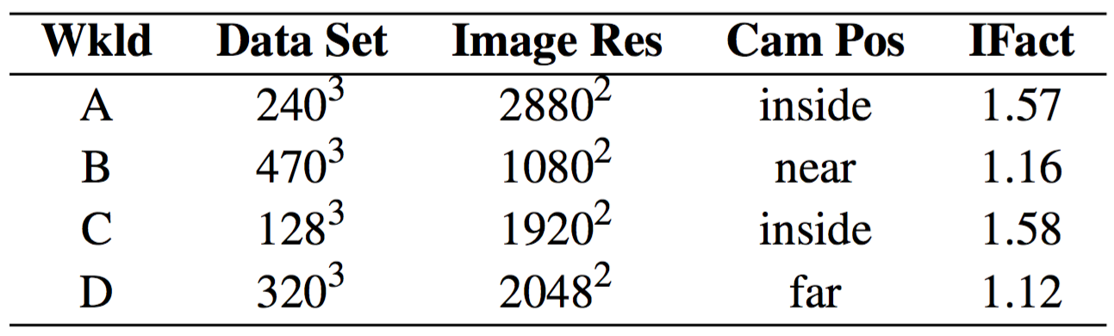

Study Overview
Imbalance Factor
Rendering workload
Camera position affects imbalance level
Imbalance Factor = max runtime/min runtime
High Imbalance Factor = more imbalanced
Rank
Camera far: All ranks have work to do
Camera inside: Imbalanced work
Far
Near
Inside
More Imbalanced

Slide 49
Study Overview
Rendering workload
MPI task concurrency
(1) MPI+TBB task per node for maximum memory allocation
8 tasks (ranks) = 192 cores
64 tasks (ranks) = 1,472 cores

Slide 50
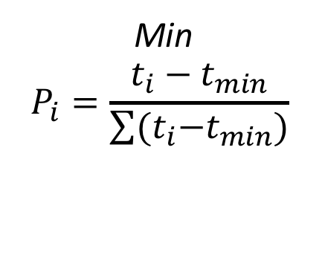
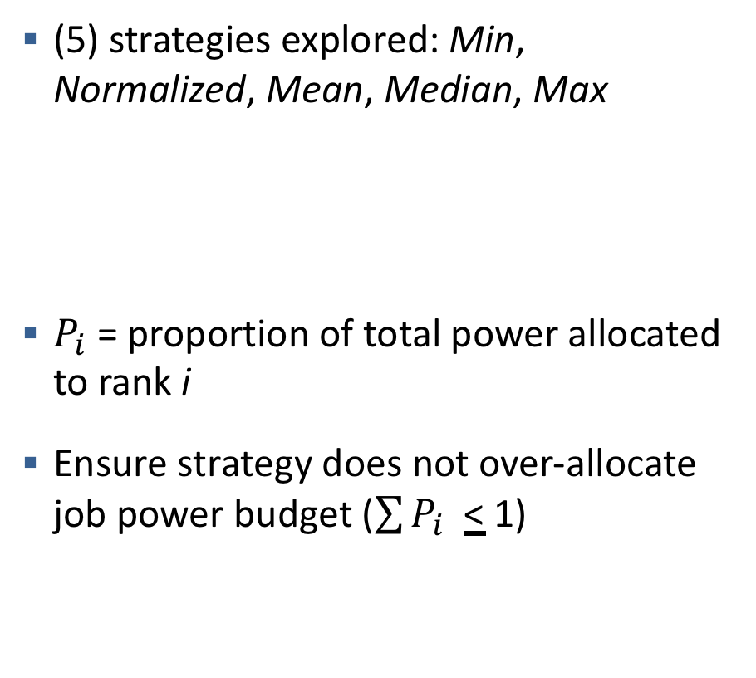
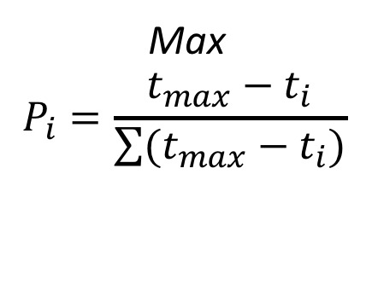
Study Overview
Rendering workload
MPI task concurrency
Power scheduling strategy
(5) strategies explored: Min, Normalized, Mean, Median, Max
$P_{i}$ = proportion of total power allocated to rank i
Ensure strategy does not over-allocate job power budget ($\sum{P_{i} }$< 1)
Min
$$P_{i}=\frac{t_{i}−t_{min}}{\sum{{(t}_{i}−t_{min})}}$$
Max
$$P_{i}=\frac{t_{max}−t_{i}}{\sum{(t_{max}−t_{i})}}$$

Slide 51
Study Overview
Rendering workload
MPI task concurrency
Power scheduling strategy
Job power budget
8 nodes : 1,840W → 1,024W
64 nodes : 14,720W → 8,192W
* 1 MPI+TBB task per node
CPU0
CPU1
115W → 64W
5W increments
115W → 64W
5W increments
Catalyst Node
: 230W → 128W
Supercomputer is not overprovisioned.
However, we artificially limit the power per node to simulate an overprovisioned environment.

Slide 52
Methodology
Rendering workload
MPI task concurrency
Power scheduling strategy
Job power budget
Varied across all factors
Vary job power budget for a single rendering workload, 8 MPI tasks, Min power scheduling strategy
Subsequent results varies 1 factor to explore effects

Slide 53
Phase 1 Results: Vary Job Power Budget
10% speedup in execution time by redistributing power to nodes with more work.
This is comparing to current strategy of uniform power distribution across nodes.
Reducing job power budget, more severe power limit
Camera Inside
More Imbalanced
Notes:
Why are we not getting speedup at the beginning? – power has been distributed, such that all nodes are performing as best as they can do
Why do we not get speedup at the end? – unable to give enough power to critical nodes

Slide 54
Phase 2 Changes
Changes: Compare Min strategy from previous phase with remaining power scheduling strategies on Rendering Workload A
Goal: Explore the effects of each strategy on an imbalanced workload

Slide 55
Phase 2 Results: Vary Power Scheduling Strategy
Min and Normalized scheduling strategies perform best under power constraints and in an imbalanced workload.
Compare all scheduling strategies.
Camera Inside
More Imbalanced

Slide 56
Phase 3 Changes
Changes: Compare best performing scheduling strategies on all rendering workloads at high concurrency
Goal: Explore the effects of best strategies on workloads of varying imbalance levels at scale

Slide 57
Phase 3 Results: Compare Rendering Configuration at Scale
Less Imbalanced
Strategy
64 Nodes
Up to 33% speedup at higher concurrencies on imbalanced workloads. Could not scale up larger due to software limitations.

Slide 58
Takeaways demonstrate the viability of using prediction to re-allocate power
We present PaViz, a power-adaptive framework for optimizing visualization performance
Using prediction to re-allocate power among nodes in a job can result in up to 33% speedup over current strategy while using the same power overall
Next research questions:
Can additional performance be realized at higher concurrencies?
How will adaptation compare to prediction for visualization workloads?

Slide 59
How can we exploit execution behaviors to improve performance of visualization algorithms?
Visualization algorithms can have more variance than simulation codes
Motivates an alternative approach for redistributing power: using prediction (rather than adaptation)
Two Results:
Show prediction is viable
Showed benefit incorporating prediction for volume rendering
Show prediction is beneficial
Extended EGPGV17, compare with runtime system using adaptation (GEOPM)
Labasan et al. “PaViz: A Power-Adaptive Framework for Optimizing Vis Performance.” Eurographics Symposium on Parallel Graphics and Visualization (EGPGV), 06/2017.
Labasan et al. “Evaluating Predictive and Adaptive Power Strategies for Optimizing Vis Performance.” In preparation for submission at IEEE Transactions on Parallel and Distributed Systems (TPDS).

Slide 60
Two approaches for power scheduling
Predictive – PaViz
Use a performance model of execution times to assign power before execution
High cost associated in creating model, and fitting it to specific-architecture
Better suited for highly irregular workloads
Adaptive – GEOPM
Monitor execution time and adapt power during execution
Behaviors from beginning iterations predict behavior of later iterations
Better suited for regular and predictable workloads
Research Question: How will the predictive and adaptive approaches compare in improving performance for visualization (rendering) workloads?

Slide 61
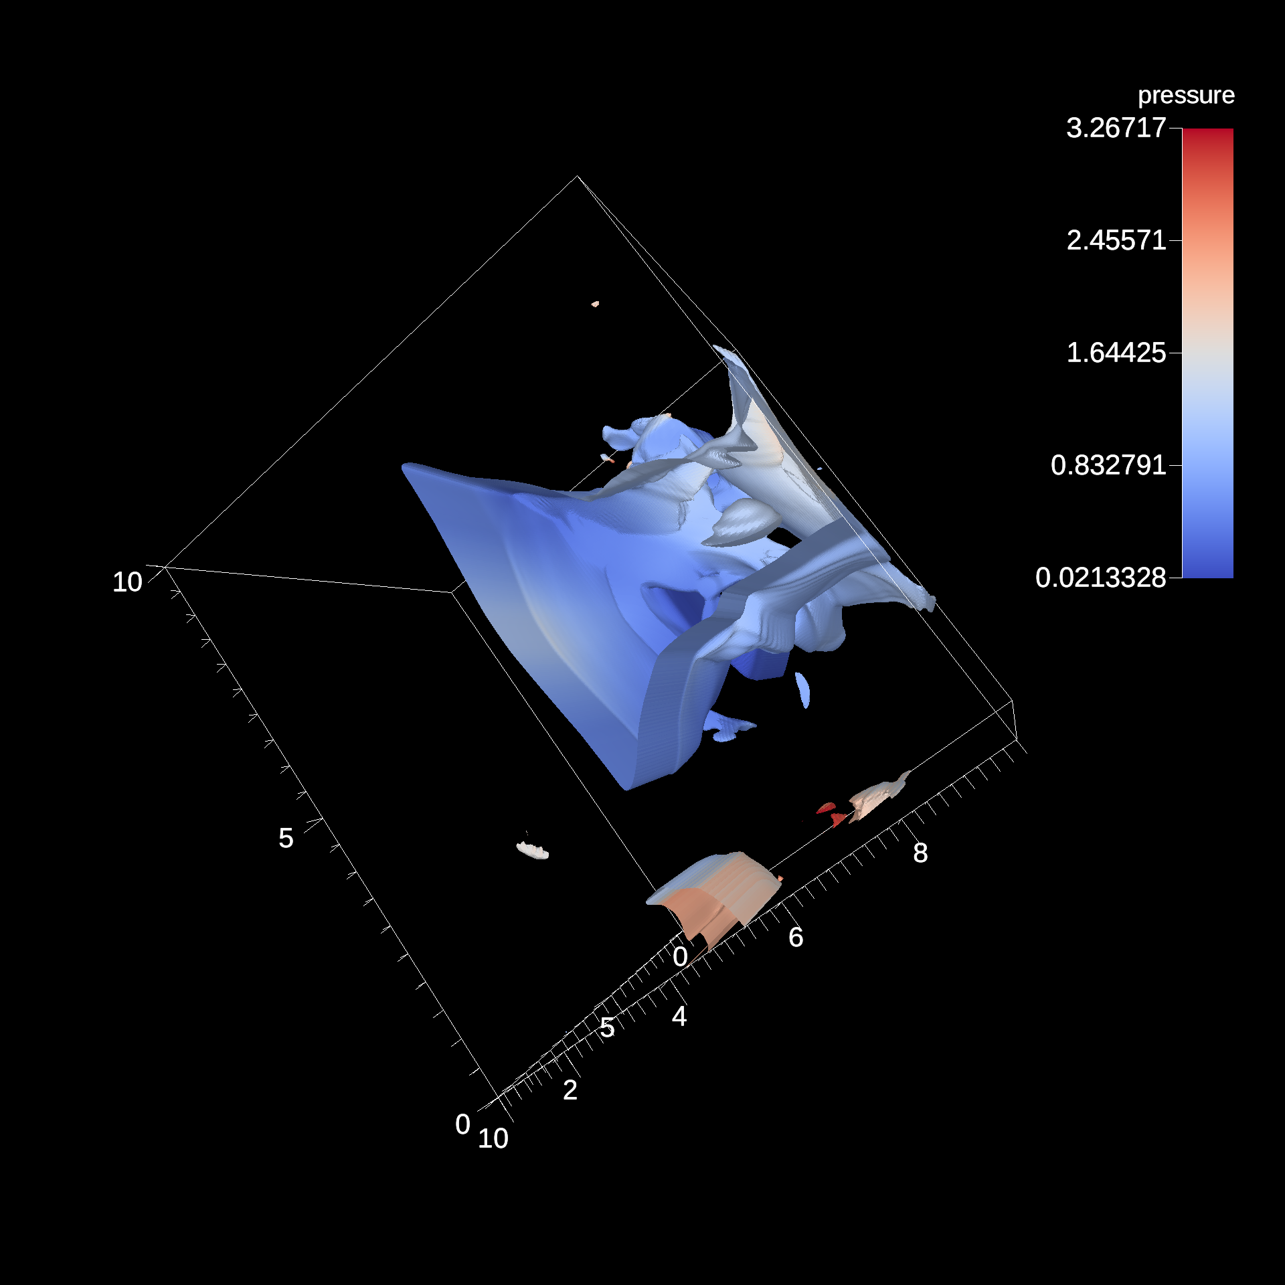
Results: Predictive strategy performs better than adaptive strategy
Scaled performance normalized to Baseline at 120W (TDP)
Predictive performs better than adaptive strategy under power constraints for this workload.
This is comparing to baseline strategy of uniform power allocations.
Total rendering time
Increasing processor power limit
128³ data set, 0.9 isovalue 1920² resolution, 170 images, 300 sim cycles, 6 vis cycles
, 8 nodes

Slide 62
Results: Increasing concurrency leads to additional performance gains
Increase Concurrency
Increase Speedup
128³ data set, 0.9 isovalue 1920² resolution, 170 images, 300 sim cycles, 6 vis cycles
Focus power limits on {50W, 60W, 70W}

Slide 63
Takeaways show better performance using prediction rather than adaptation for scheduling power
Dynamically scheduling power within a job can be done by using prediction or using adaptation of execution behaviors
Using prediction to re-allocate power can improve performance by up to 27% over using adaptation for imbalanced workloads, while using the same power overall

Slide 64
Dissertation Question: “Can Visualization Be Optimized on Power-Limited Supercomputers?”
Involves the intersection of two topics:
Power-constrained high performance computing
Scientific visualization
Focus: Visualization workloads are different than simulation workloads...leads to two questions:
How different are visualization workloads?
How does this affect power optimization strategies?
Labasan et al. “Exploring Tradeoffs Between Power/Performance for a Vis Algorithm.” IEEE Symposium on Large Data Analysis and Visualization (LDAV), 10/2015.
Labasan et al. “PaViz: A Power-Adaptive Framework for Optimizing Vis Performance.” Eurographics Symposium on Parallel Graphics and Visualization (EGPGV), 06/2017.
Time
Characterize Data Intensity
Labasan et al. “Power/Performance Tradeoffs for Vis Algorithms.” Accepted for publication at IEEE International Parallel and Distributed Processing Symposium (IPDPS).
Power Scheduling
Labasan et al. “Evaluating Predictive and Adaptive Power Strategies for Optimizing Vis Performance.” In preparation for submission at IEEE Transactions on Parallel and Distributed Systems (TPDS).
Notes:
Firstly, I want to present the overarching thesis question, which is ”Can scientific visualization workloads be optimized on power-limited systems?”

Slide 65
Dissertation Question: “Can Visualization Be Optimized on Power-Limited Supercomputers?”
Dissertation Answer: Yes!
Because:
We evaluated tradeoff opportunities between power and performance for different input parameters (e.g., data set size, algorithm implementation).
We exploit these tradeoffs in a performance model and show performance improvement by shifting power in a power-limited environment at large scale.

Slide 66
Future Research Directions
Explore power and performance tradeoffs for other hardware architectures
Gain better understanding of execution behaviors on heterogeneous platforms
Evaluate when to use prediction or adaptation in dynamically reallocating power to improvement performance for irregular workloads
Prediction has large overhead costs, but is better suited for unpredictable workloads
Adaptation is online, but may not converge on irregular workloads
Create additional performance models for more visualization workloads
Develop a power-aware central resource manager

Slide 67
Optimizing Visualization Performance on Power-Limited Supercomputers

Slide 68
Standard practice for overprovisioning
Setting processor power limits requires user space access to Intel registers
This is a large request of large scale systems
LLNL’s solution: msr-safe (github.com/llnl/msr-safe)
Kernel driver providing user space access through a whitelisting mechanism
Enables overprovisioning research at scale on certain Intel machines
Required by Intel’s GEOPM, included with OpenHPC release
This is in line with what the overprovisioning community is using

Slide 69
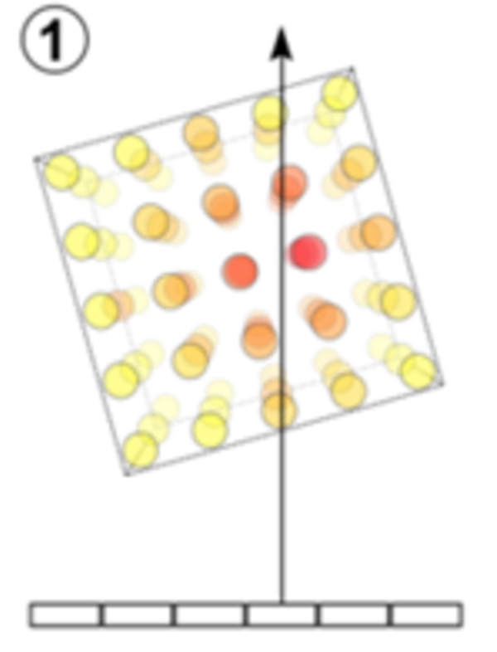

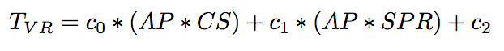
Volume Rendering Performance Model
Image-order algorithm
For each pixel, trace a ray through the volume and sample at regular intervals
Volume rendering performance is influenced by three key factors:
Number of unique cells sampled
Total number of samples
Number of pixels in image vs. number of active pixels
Predicted time to complete volume rendering per node:
AP = number of active pixels
CS = number of cells spanned
SPR = samples per ray
x
Image Size
x
Active Pixels
x
x
Sample Along The Ray
Screen Space Bounding Box
Larsen et al. “Performance Modeling of In Situ Rendering”, SC16.
Cell Frequency
Sample Frequency

Slide 70
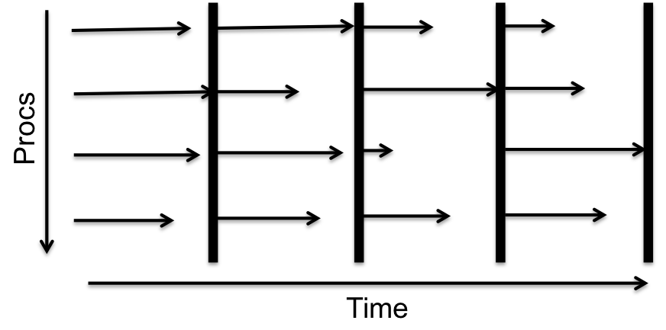
Load imbalances pose a performance challenge
Massively distributed bulk-synchronous applications
Global synchronization barriers at computation milestones
Load imbalance manifestation: manufacturing variation, OS jitter, problem does not divide evenly, etc.
Performance determined by last compute unit to arrive at the barrier
Speed up slower processors
Slow down faster processors
Critical Path

Slide 71
Improving performance with intra-node power management
Improve application performance by leveraging fine-grained power management capabilities within a node
Track thread progress within a loop, assign relative frequencies to each thread, check progress
Idea: Should be able to request higher than expected frequency
Prototyping work influenced next generation architectures
Labasan et al. Mitigating load imbalances through hierarchical performance balancing. US Patent Application No: US20170277576A1. Pending patent.

